Slide 1
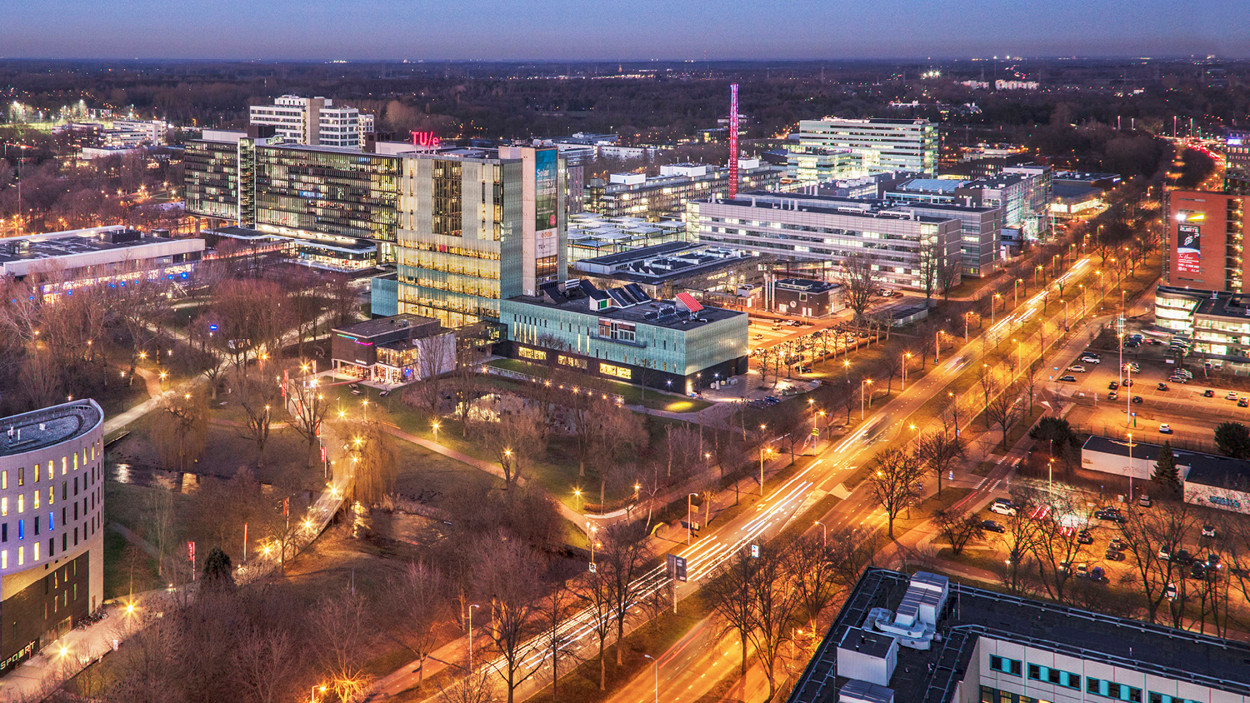
Dynamic Graph Visualization on WebGL
Guangyu Li
Visualization Group

Slide 2
Dynamic Graph Visualization
Evolution of relationships between entities.
Temporal graph used to store the event between entities.

Slide 3
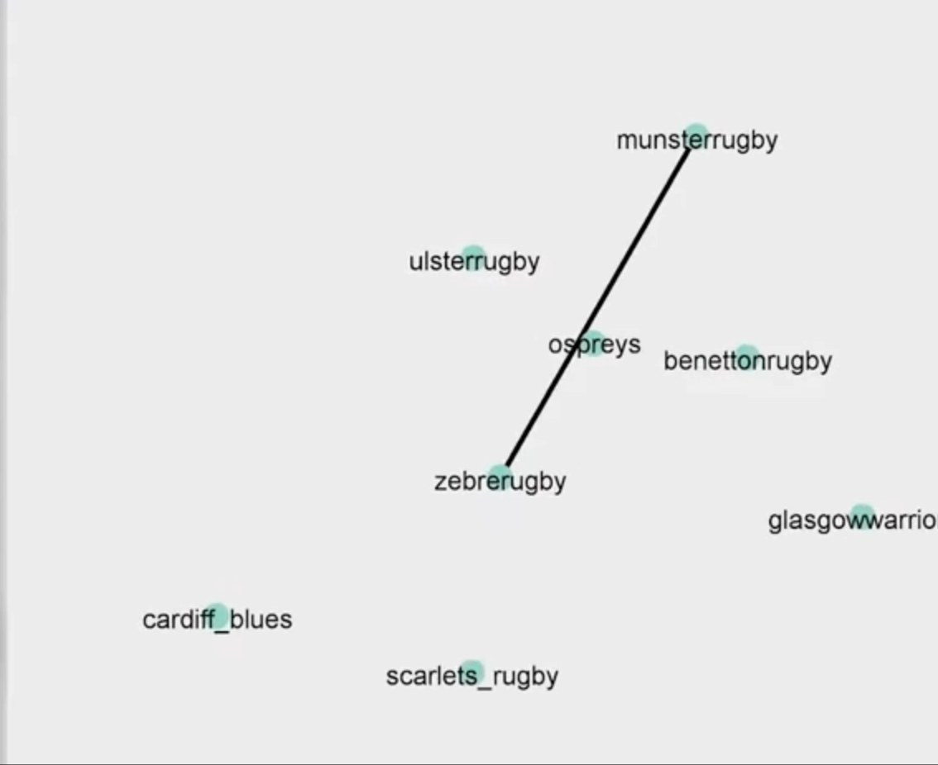
Dynamic Graph Visualization Demo
Rugby teams' competition network

Slide 4
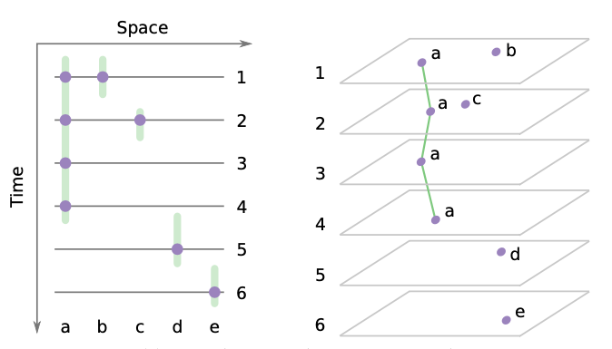
Dynamic Graph Approaches
Time-sliced Graph
Static graph in every snapshot
Advantage on structured data---Vandebunt
Loss information for potential events
Difficult to decide the slices

Slide 5
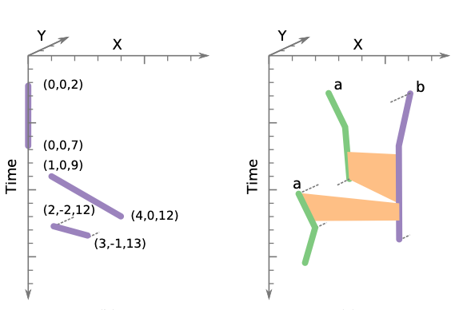
Dynamic Graph Approaches
Integrated Diagram
Convert time to distance in 3D Space
Preserve all the details of temporal network
Difficult in data volume and computation complexity

Slide 6
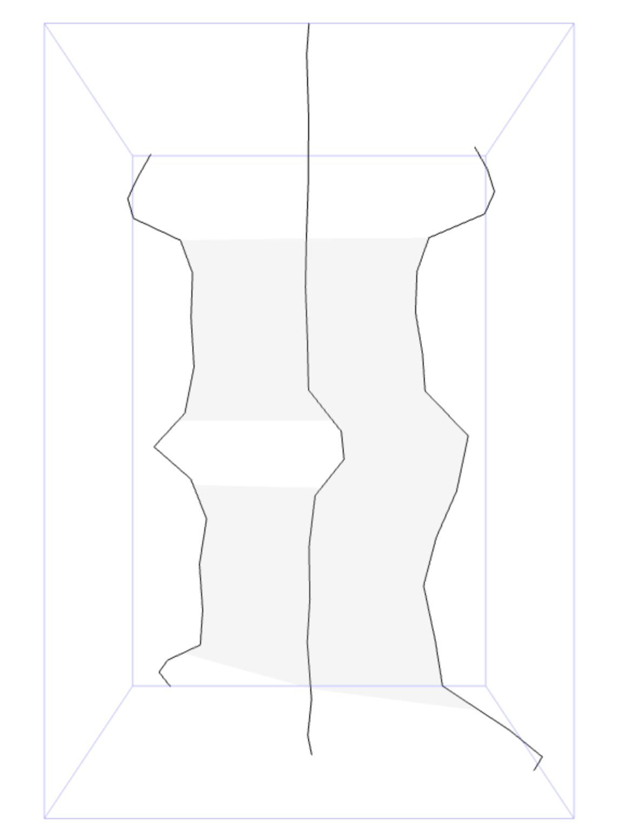
Dynamic Graph Computation
Force-directed algorithm
Node Repulsion
Edge Attraction

Slide 7
Dataset
Vandubent: Student relationship on 7 different timeframe
Time-sliced
32 nodes and 49 connections
Rugby: Rugby football teams competition news on Twitter(X) over a year
Continous
12 nodes and 888 connections(merged repeated news)
Dialog: Dialog from all chapters of book “Pride and Prejudice”
Continous
118 nodes and 3481 connections

Slide 8
Force-based Algorithms
Gravity
compact drawing of node trajectories
Time Straightening
smooths node trajectories, reducing node movements over time
Edge Attraction
attractive force pulls trajectories that are linked by an edge closer to each other
Node Repulsion
force repels trajectories from each other

Slide 9
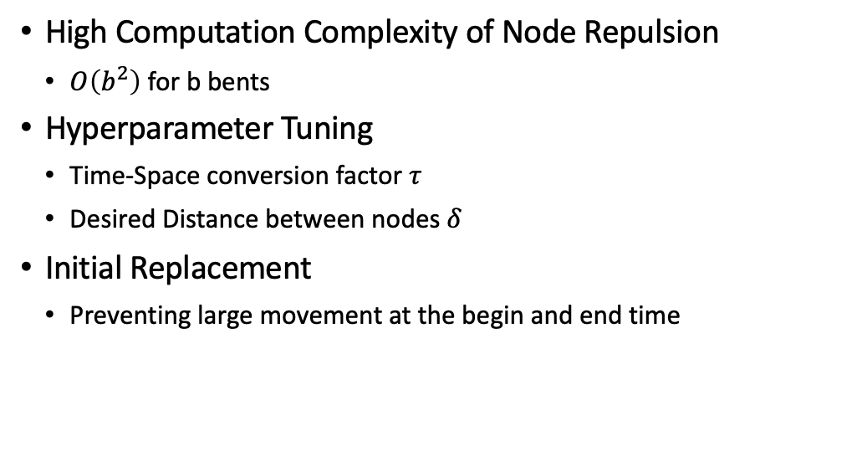
Challenges
High Computation Complexity of Node Repulsion
$O\left(b^{2}\right)$ for b bents
Hyperparameter Tuning
Time-Space conversion factor $τ$
Desired Distance between nodes $δ$
Initial Replacement
Preventing large movement at the begin and end time

Slide 10
Improvement
Exploiting WebGL Parallel Computation on Node Repulsion
Split force calculation to each node and compute parallelly
Hyperparameter Tuning
AutoTau
Initial Replacement
Pre-calculation the average connection of nodes and make cluster initially.

Slide 11
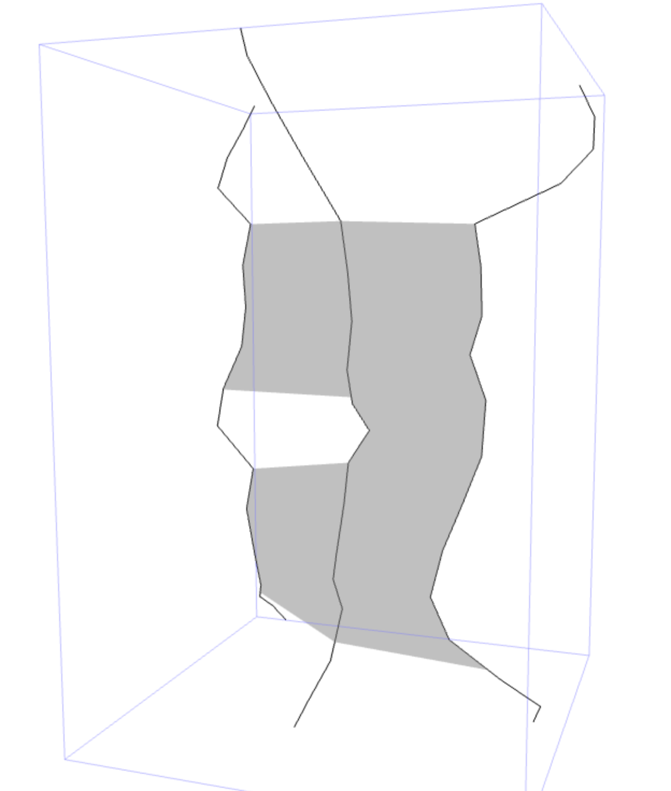
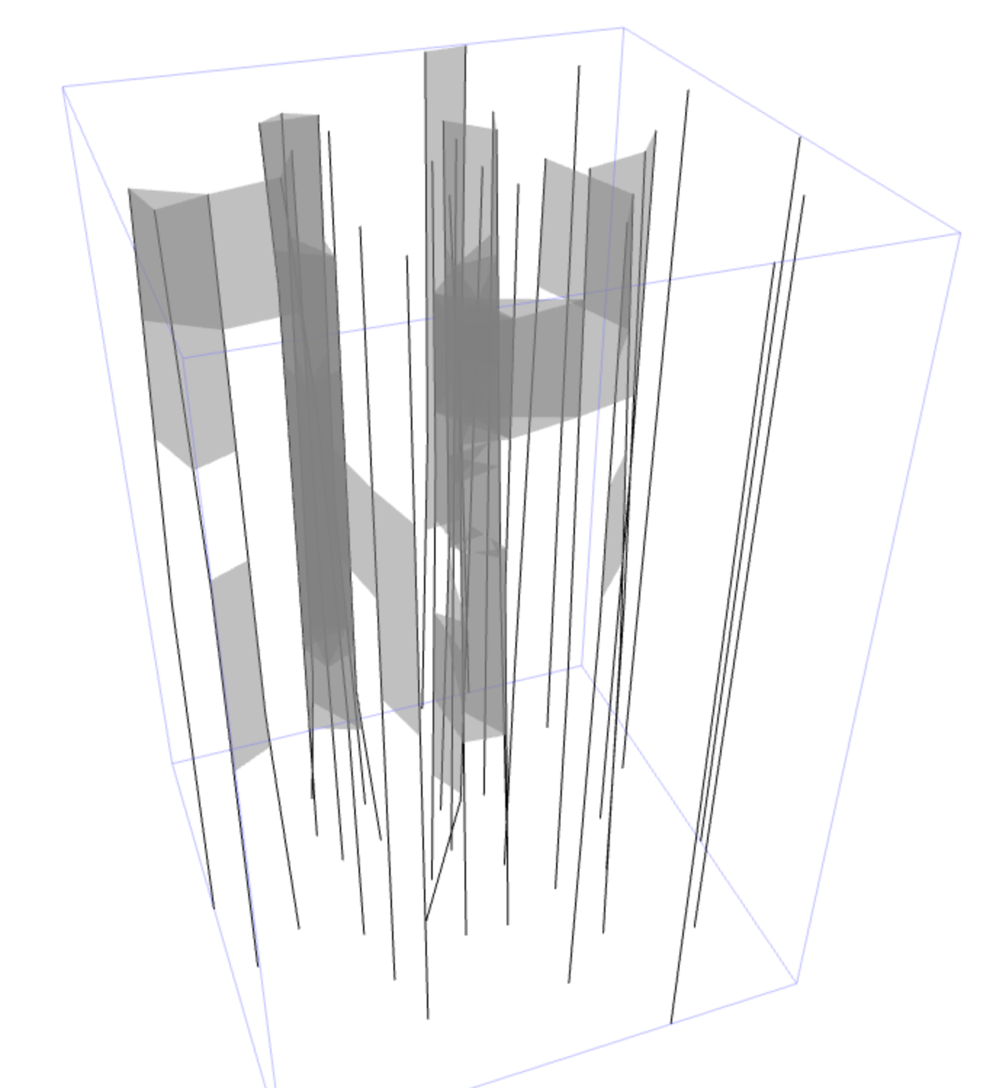
Visualization---Time-Space Cube
Simple Graph with 3 nodes
Vandebunt Dataset

Slide 12
Experiment
Challenges:
Computational complexity on large datasets
Visualization quality
Crowding: average 2D movements of the nodes
Movement: times nodes pass close to each other in animation
Stress: measures the Euclidean distances in a graph layout preserve the shortest path distances in the original graph.

Slide 13
Q&A

